Slide 1
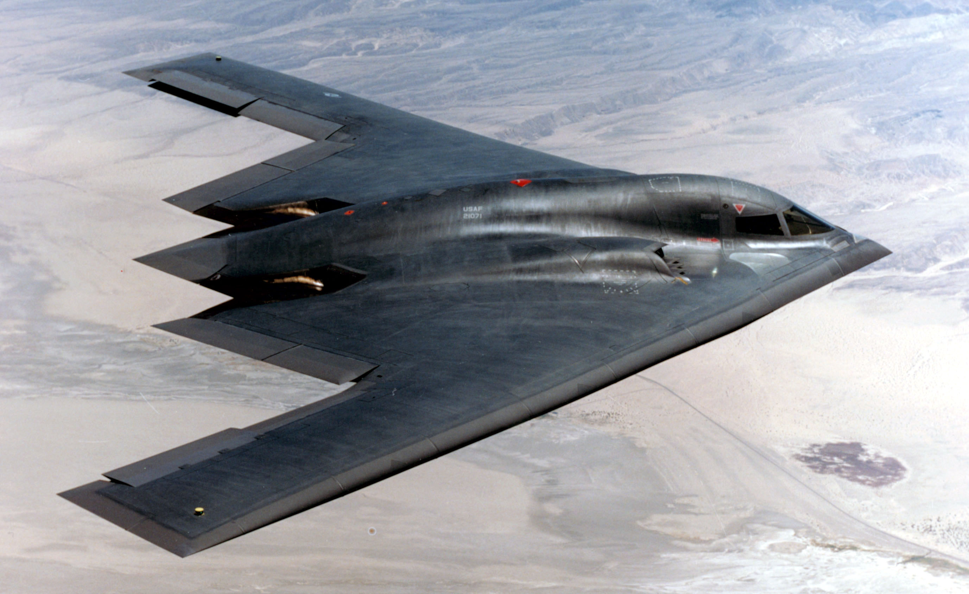
Cost of ownership of military aircraft
UNCLASSIFIED
Cost to purchase: $1.16 billion
Cost to fly per hour: $128,805
Manufacturer: Northrop Grumman
Model: B-2
Mission : “Bomber”

Slide 2
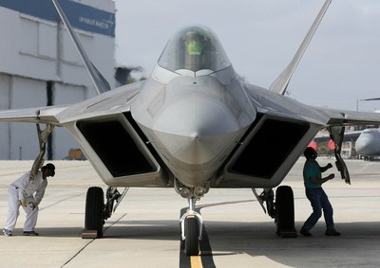
Cost of ownership of military aircraft
UNCLASSIFIED
Cost to purchase: $143 million
Cost to fly per hour: $59,166
Manufacturer: Lockheed Martin
Model: F-22
Mission : “Fighter”

Slide 3
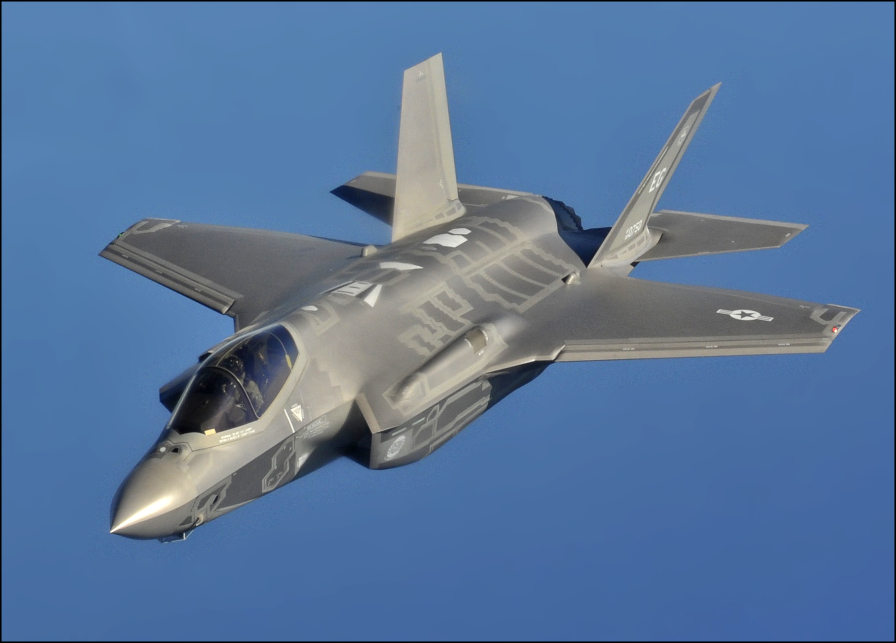
Cost of ownership of military aircraft
UNCLASSIFIED
Cost to purchase: $108 million
Cost to fly per hour: $42,169
Manufacturer: Lockheed Martin
Model: F-35
Mission : “Fighter”

Slide 4



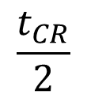
Fatigue life of an aircraft
UNCLASSIFIED
$$a_{CR}$$
Critical crack size,
Crack size
Crack growth curve
a₀
Flight hours
Inspection interval
$$\frac{t_{CR}}{2}$$
$$t_{CR}$$
Retirement age

Slide 5
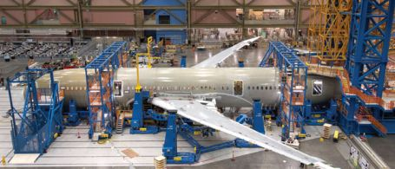
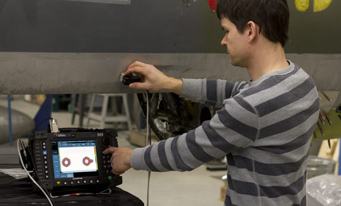
Maintaining the safety of aircraft against fatigue failure
Inspection
(Crack detection)

Slide 6
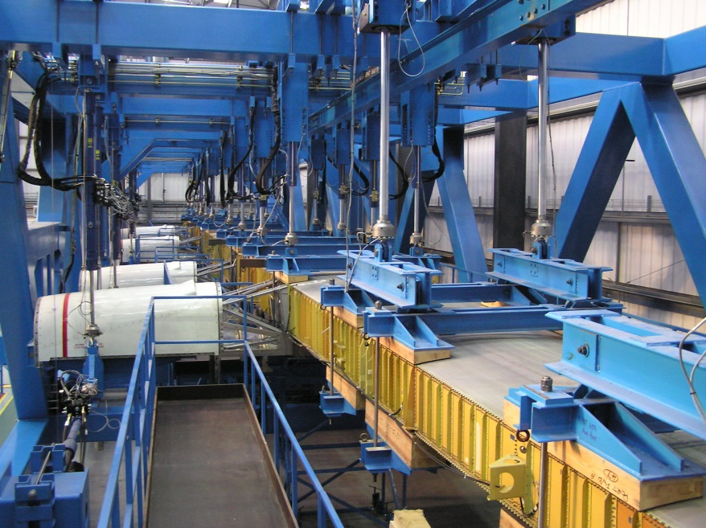
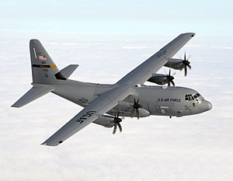
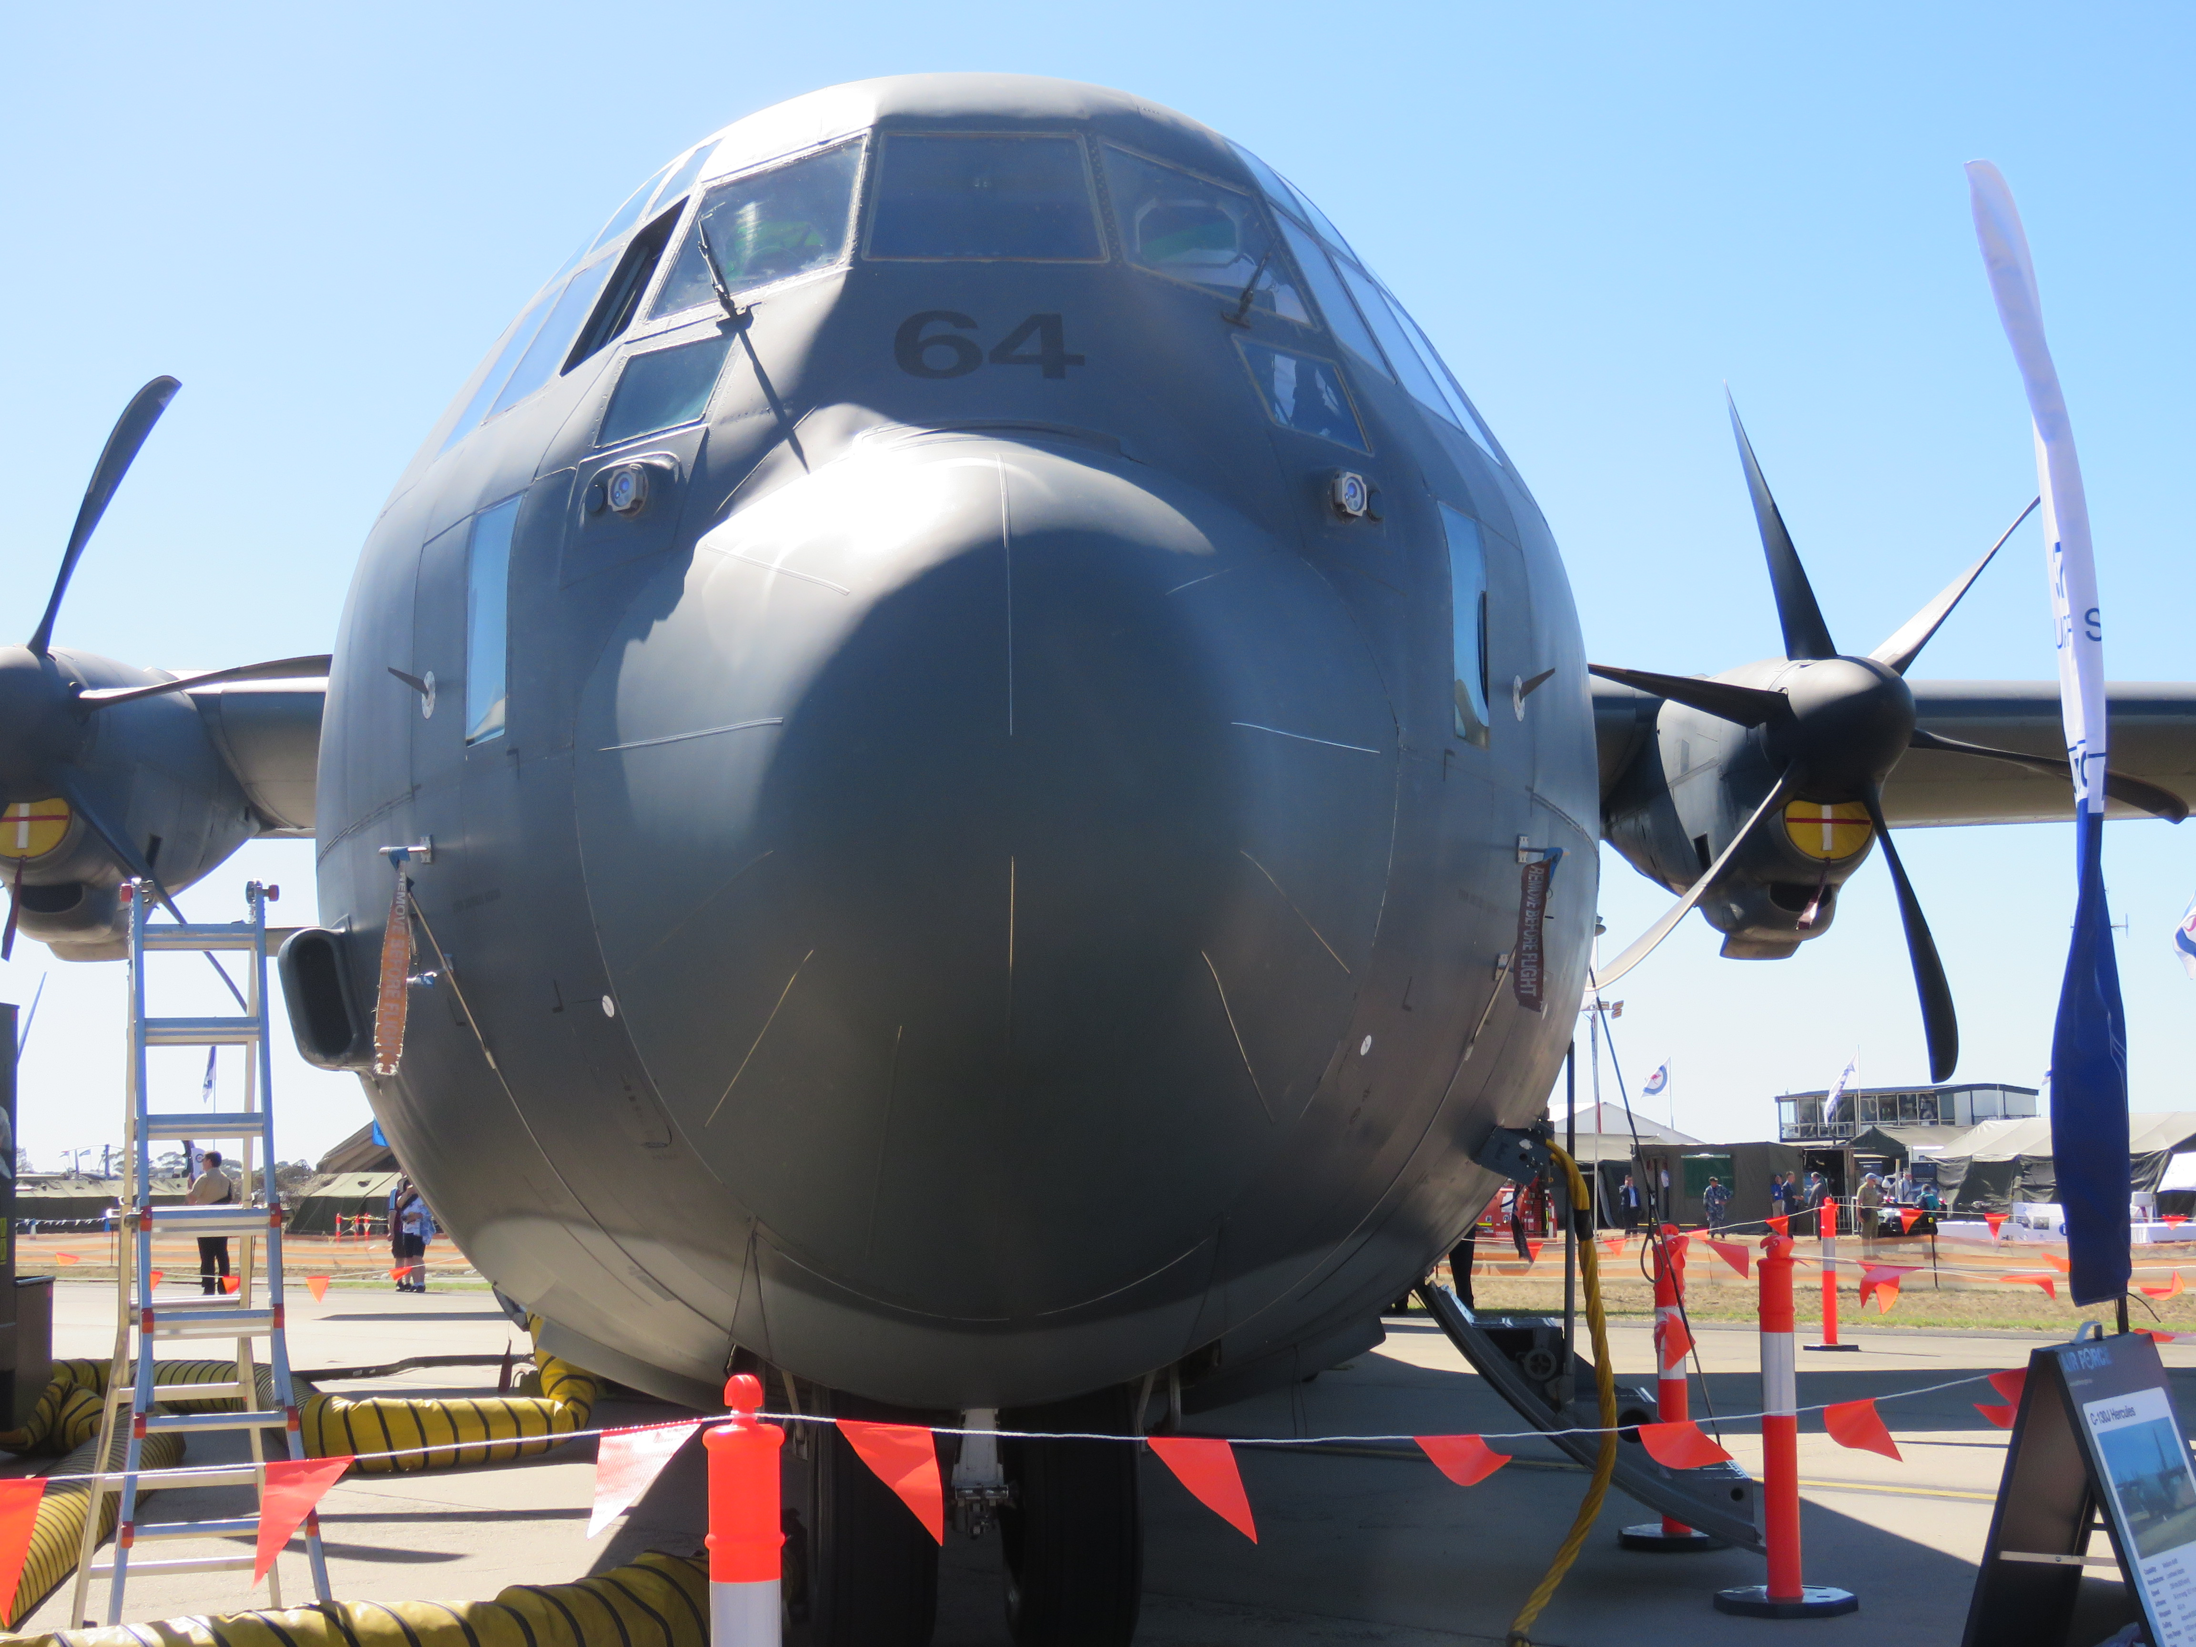
Full Scale Wing Fatigue Testing of C-130J Military Transport Aircraft
UNCLASSIFIED
Maintaining the safety of aircraft against fatigue failure

Slide 7
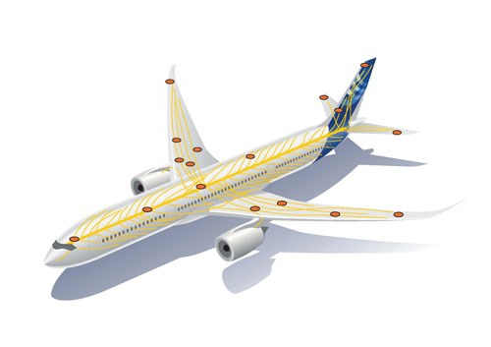
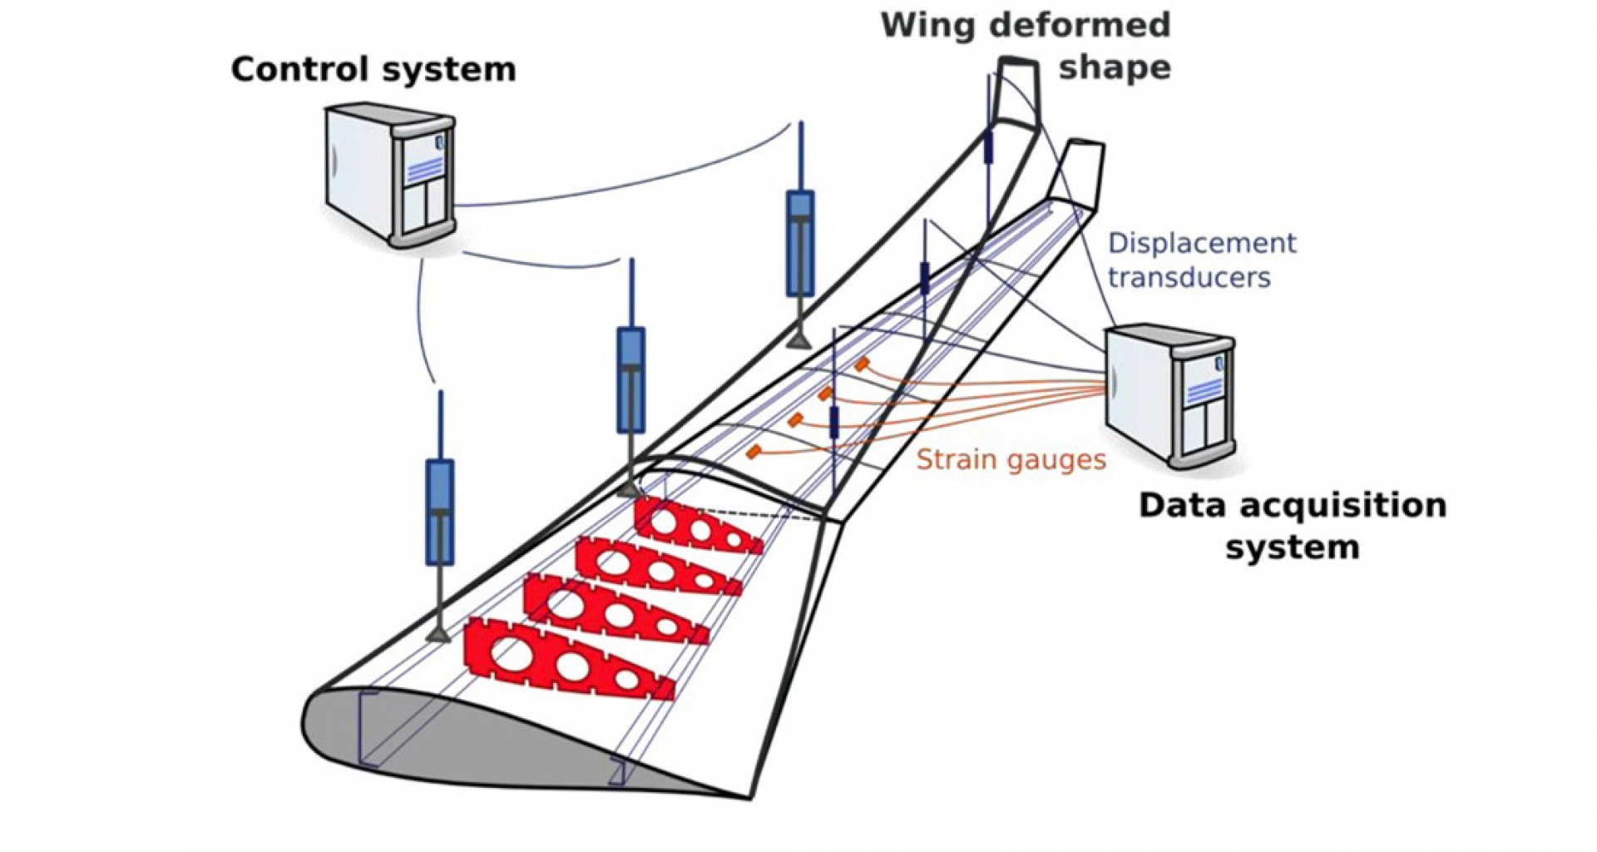

Determining dynamic loading of airframes
UNCLASSIFIED
Strain gauge sensors installed on airframe
Strain data obtained
Strain converted to stresses
$$Stress=E ∗ Strain$$

Slide 8
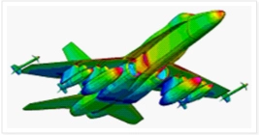
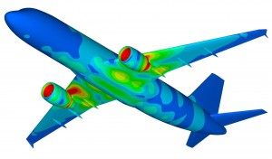

Finite Element Structural Analysis
UNCLASSIFIED
Maintaining the safety of aircraft against fatigue failure
Determine the locations with critical stress
Analyse the fatigue crack propagation
Optimise the airframe component sizing

Slide 9
Currently there is only one Finite Element Structural Analysis and Design software for civil structures that is developed by a graduate from a Philippine university.
UNCLASSIFIED
Structural Analysis and Design Software Trivia
Do you know that?
It is developed by a Cebu Institute of Technology - University alumnus (BSCE-91)
Software full version is free to everyone who is present in this lecture

Slide 10
Called FCE until 2005
UNCLASSIFIED
Structural Analysis and Design Software for Civil Structures
Filipino Civil Engineers
For Civil Engineers
from 2006 onward
FrameCE
http://www.framece.com/

Slide 11
UNCLASSIFIED
Conclusions
Fatigue problems in engineering structures is :
Complicated
Need more research
Probabilistic or risk-based approach necessary

Slide 12


UNCLASSIFIED
Questions?
Causes fatigue
Fatigue problems in students

